Slide 1
Chattanooga Dances!
October 18, 2018
Chattanooga Dances! highlights the city’s
non-profit dance companies along with those schools
that maintain a fulltime dance curriculum.
This community collaboration began in 2001.
CCA is proud to sponsor this yearly community collaboration.
Featuring
Ballet Tennessee
Baylor School/Verve
Barger Elementary Movement Makers
Chattanooga Ballet
Center for Creative Arts/Project Motion
GPS/Terpsichord
All Photos by Paul Kieu

Slide 2
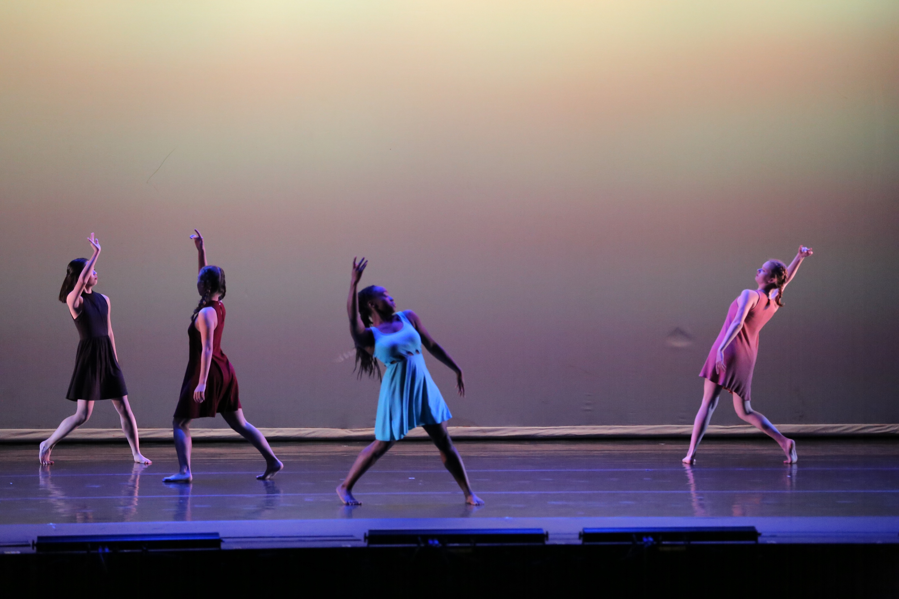
All I Give
Project Motion/CCA
Choreography: Caio Godoy
* 1st place winner in the 2018 Cathie Ault Kasch Student Choreography Project at the Tennessee Dance Festival at MTSU.
Perfect
Project Motion/CCA
Choreographic Direction: Jessica Laliberte Bowman with movement invention by the dancers

Slide 3
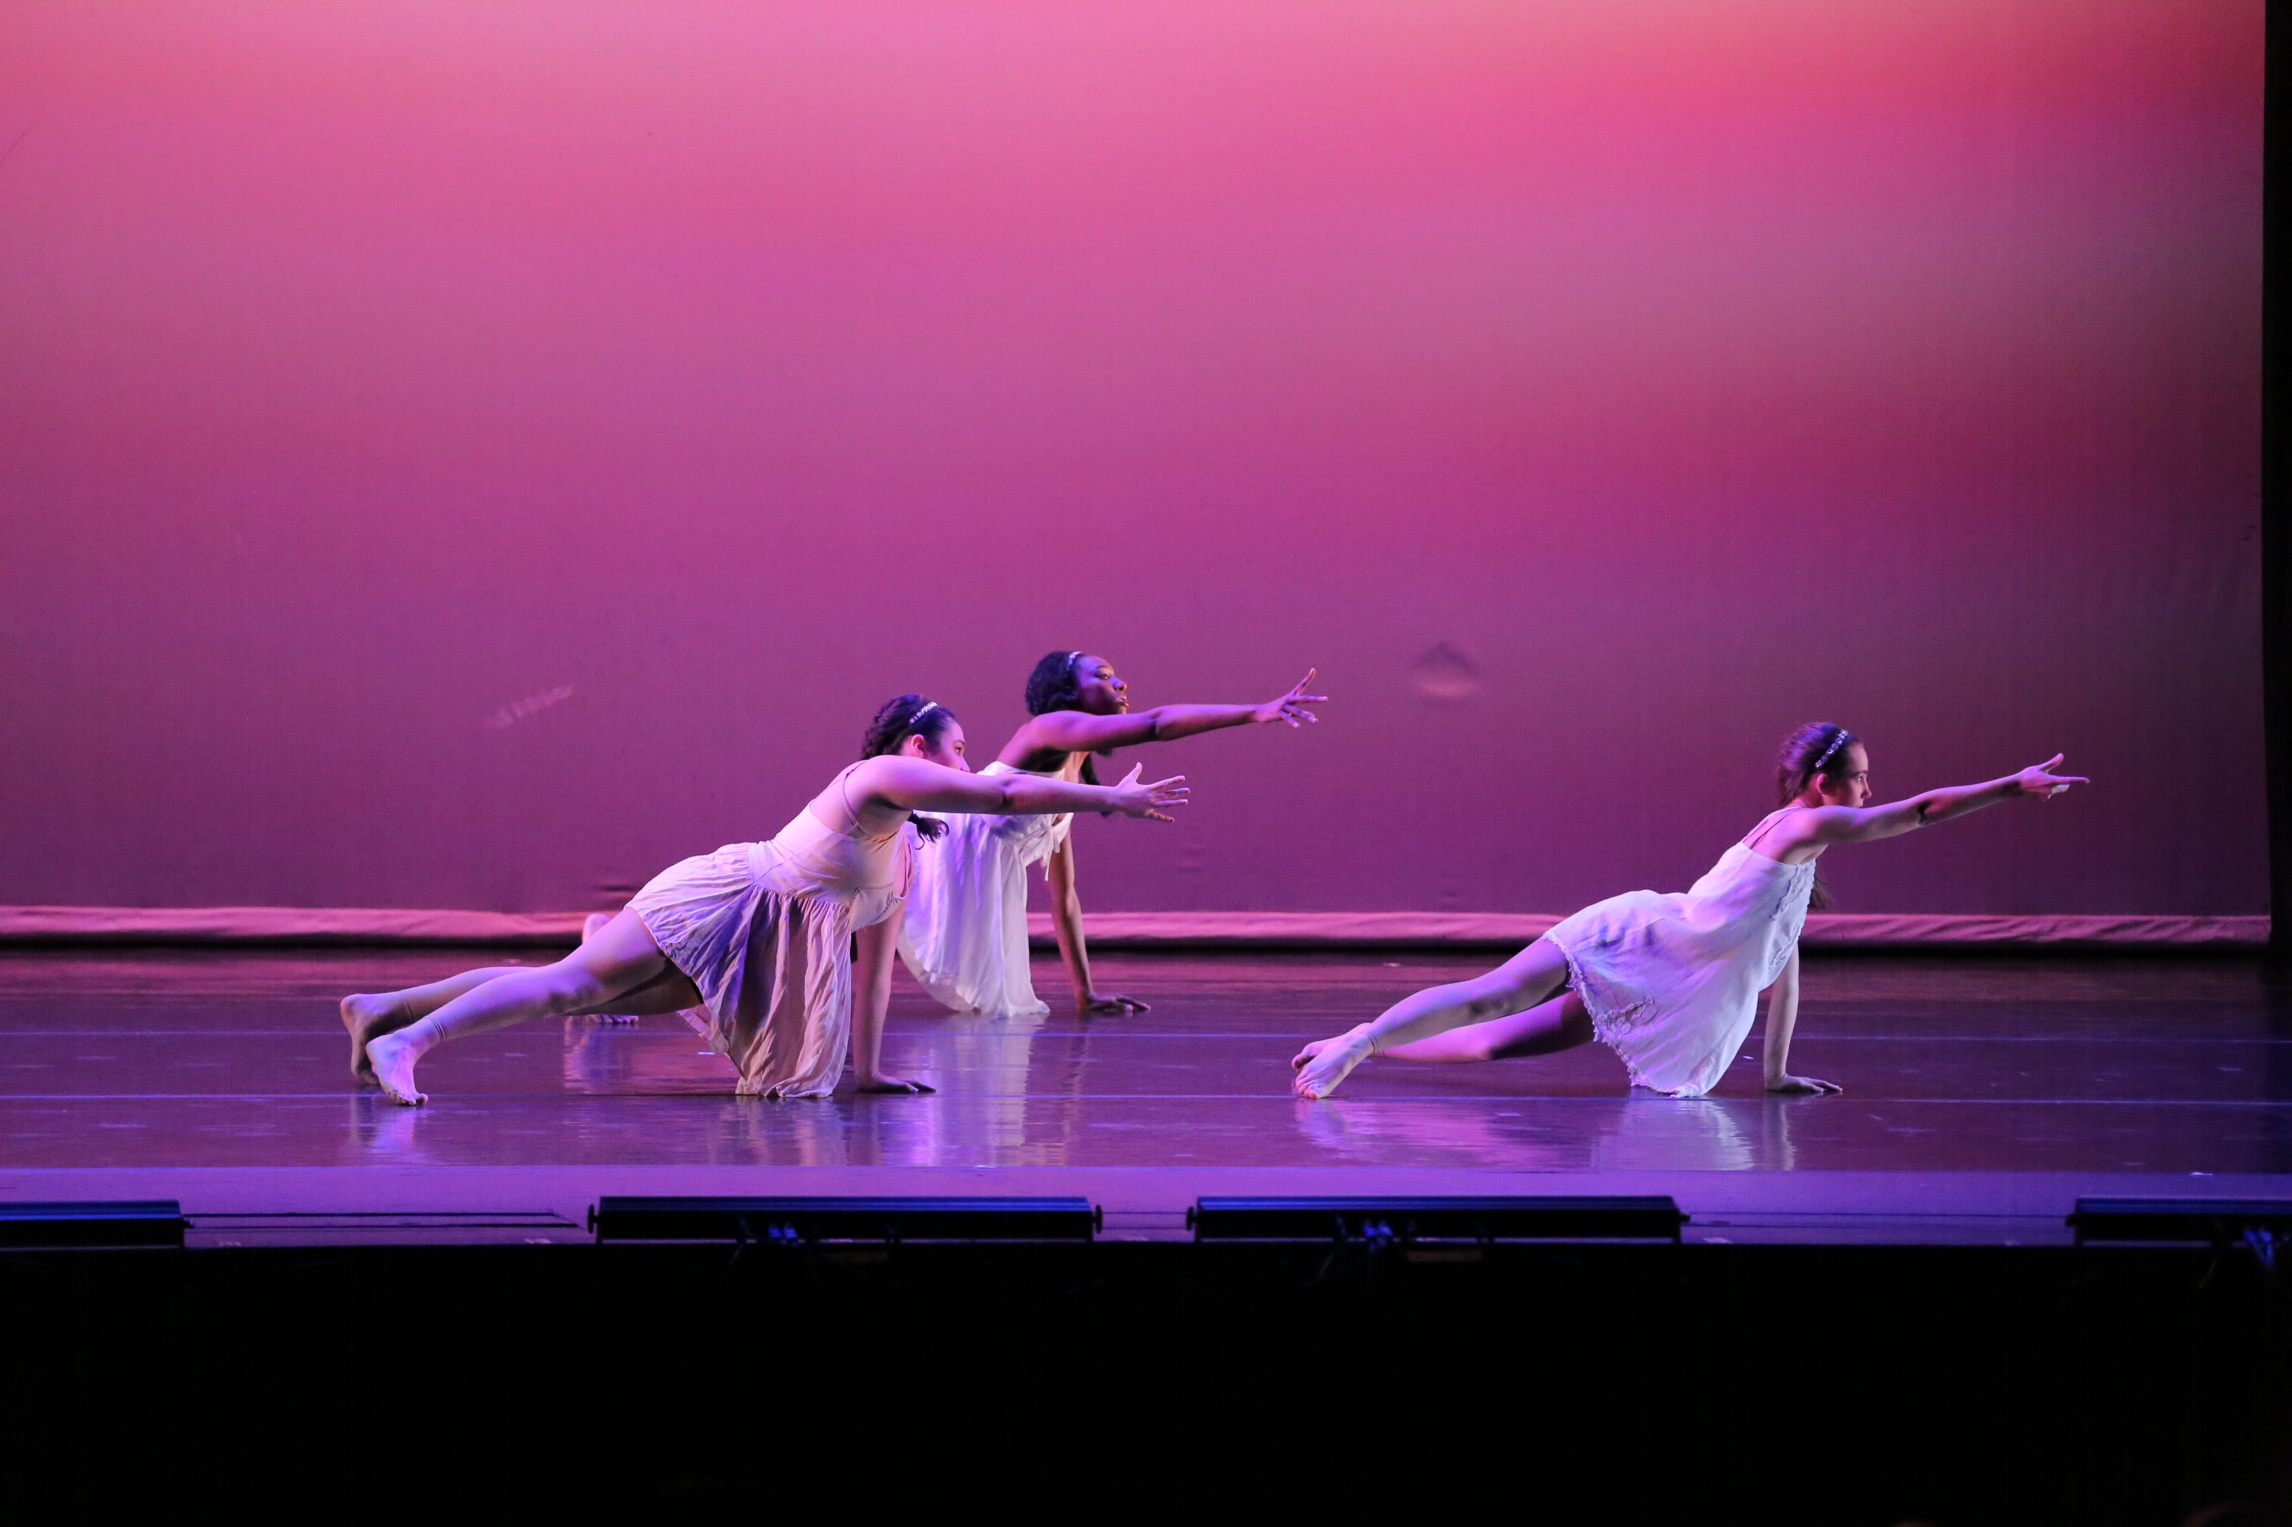
Voiceless
Verve/Baylor
Choreography: Brie Timmons

Slide 4
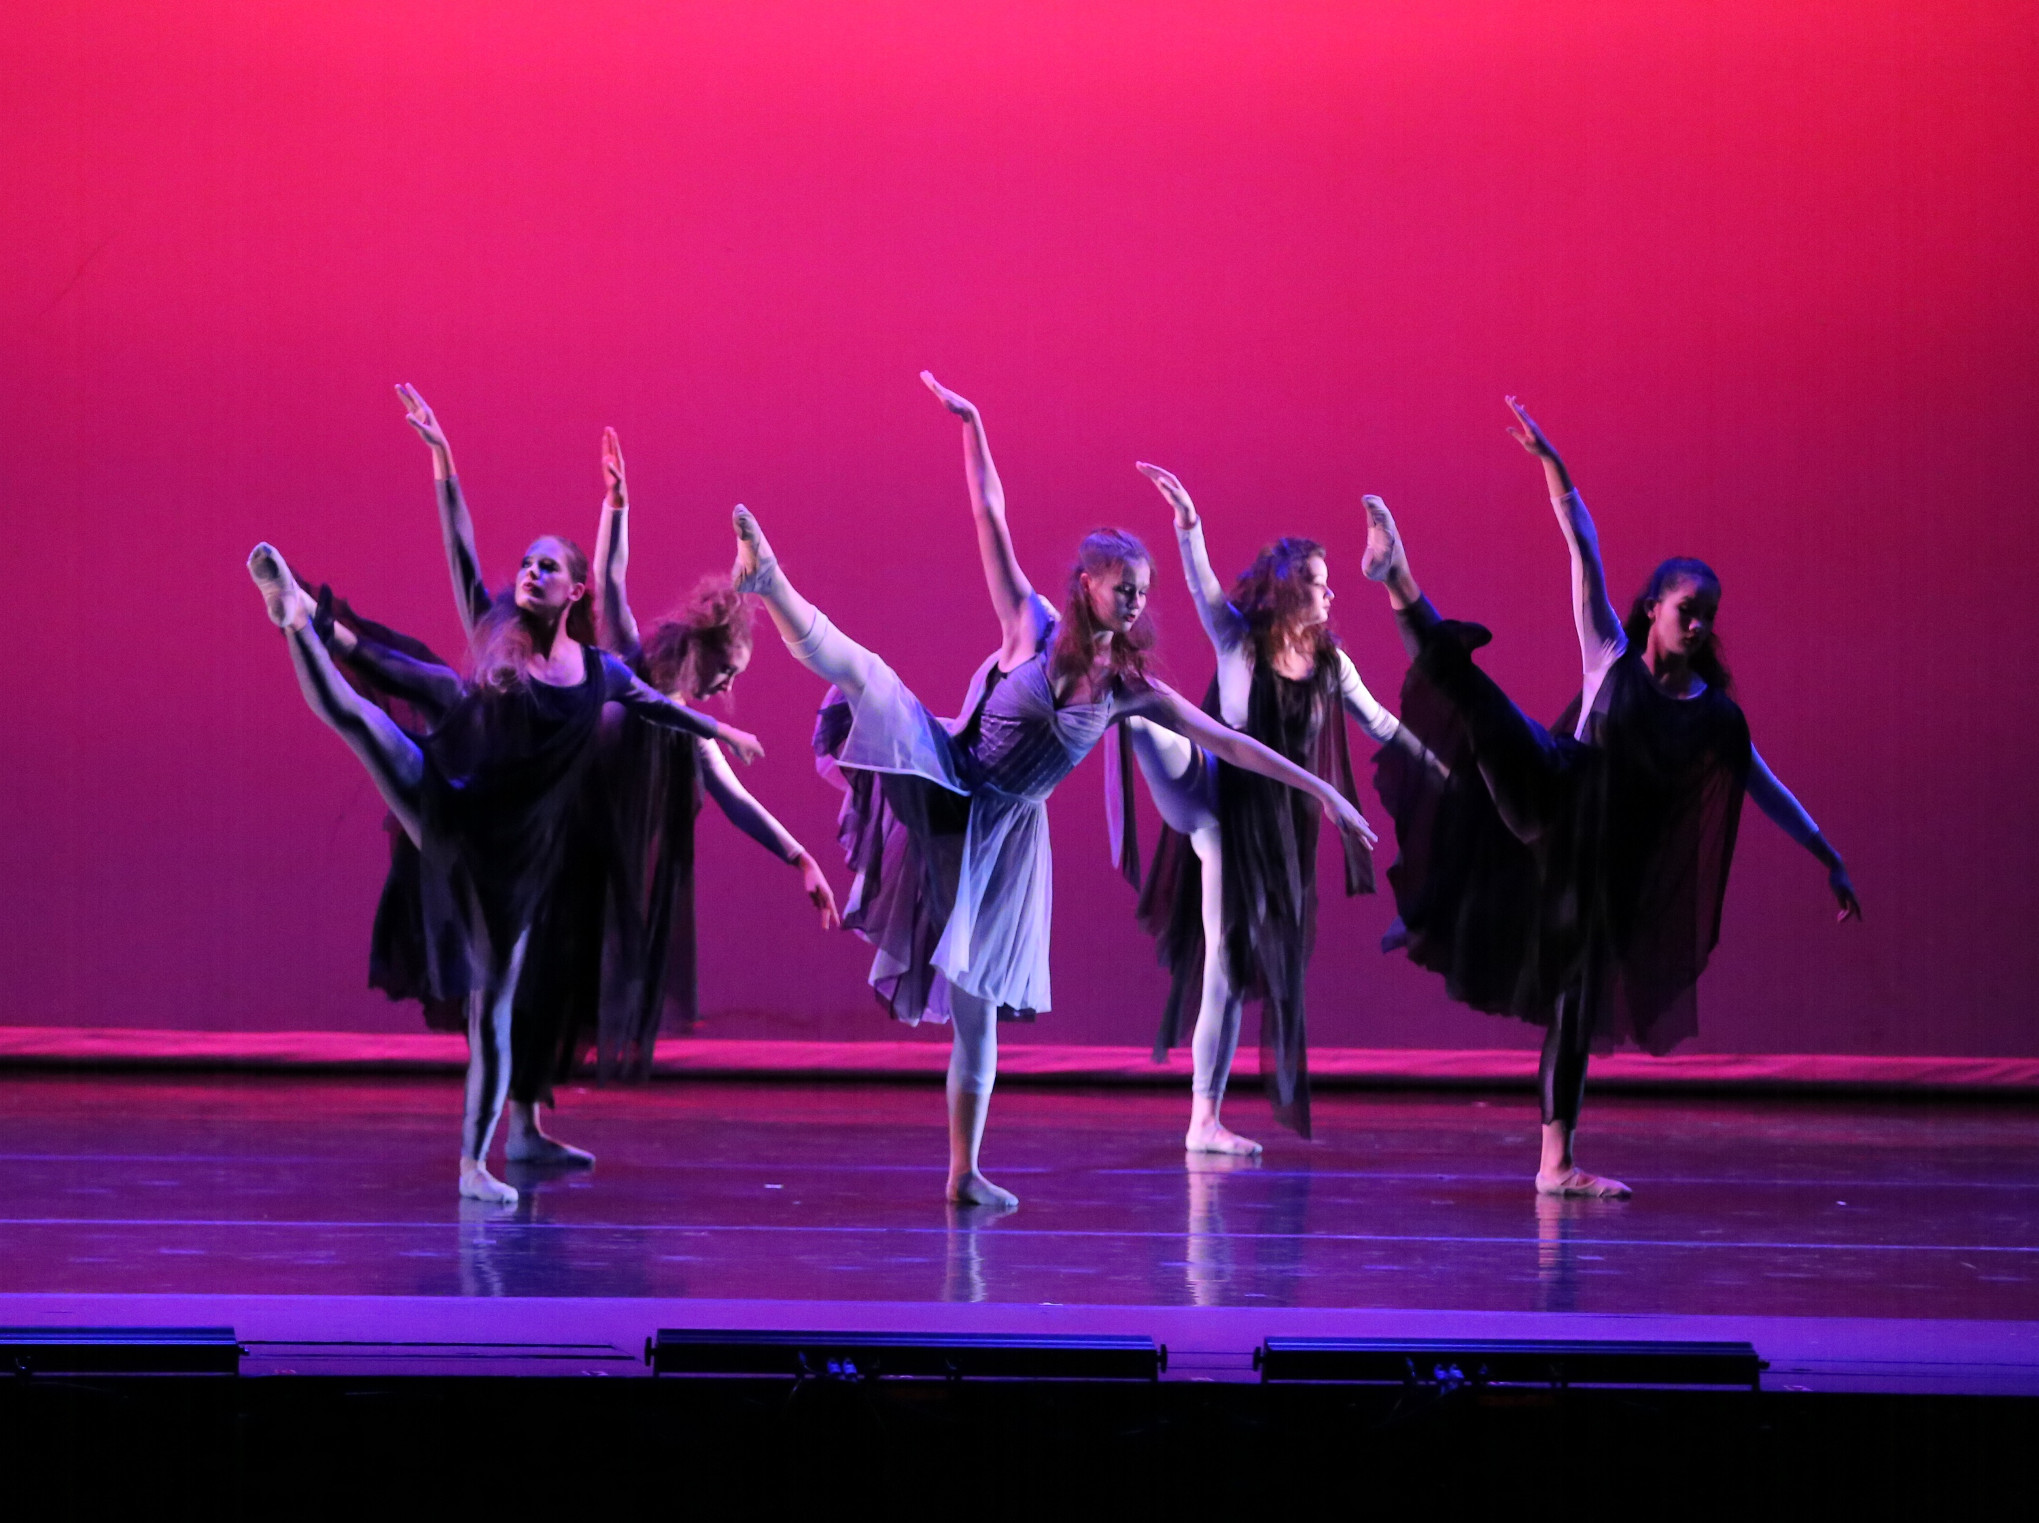
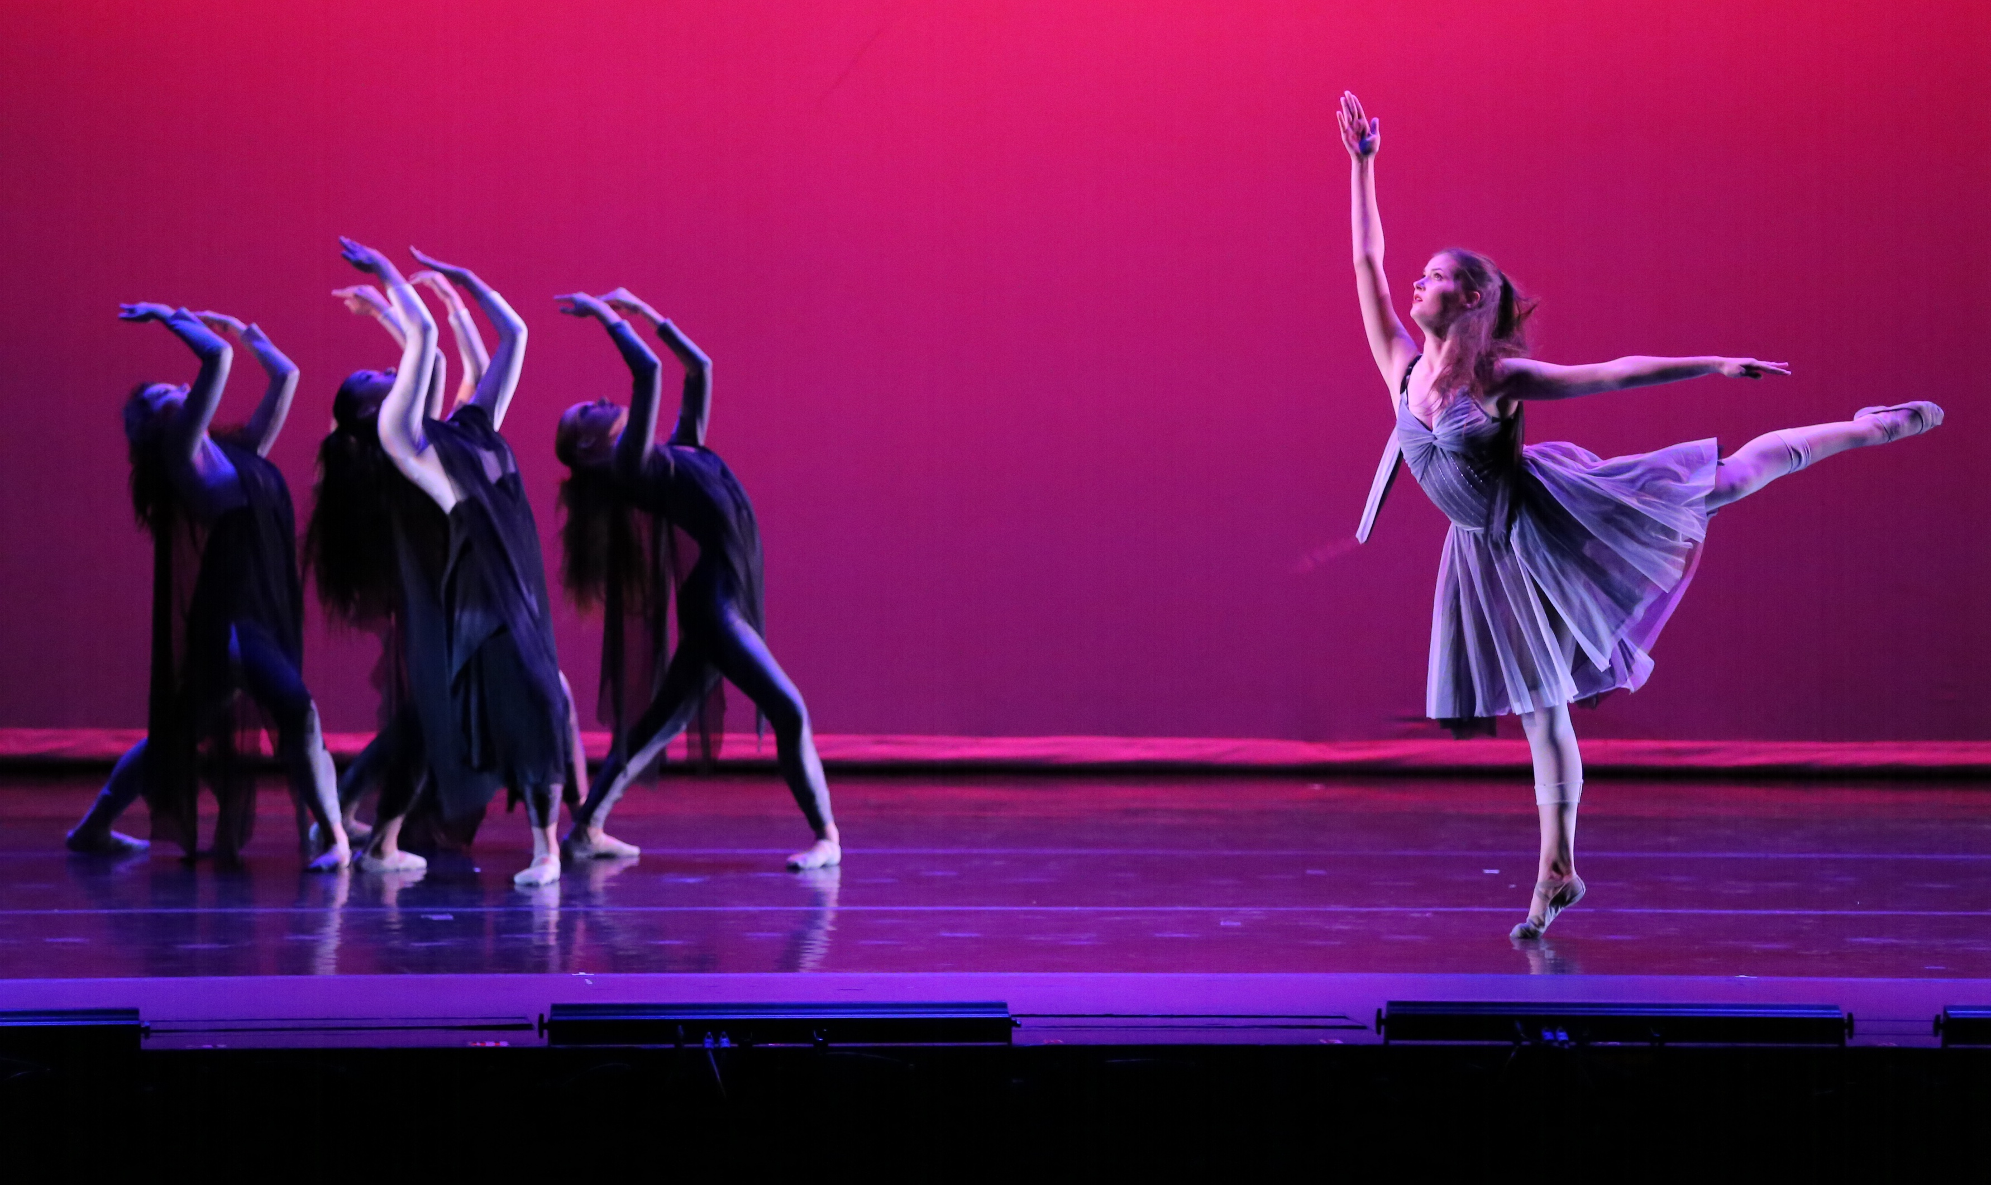
Ravage
Ballet Tennessee
Choreography: Jenison Owens

Slide 5
Next Level
Barger Academy Movement Makers
Choreography by Felicion McMillon-Diakhate
Nameless
Movement Makers/ Barger Academy
Choreography by: Felicion McMillon-Diakhate, Amari Hines, Kiya England, Jada Gladden, Lovelei Pulliam and Aliyah Mastin

Slide 6
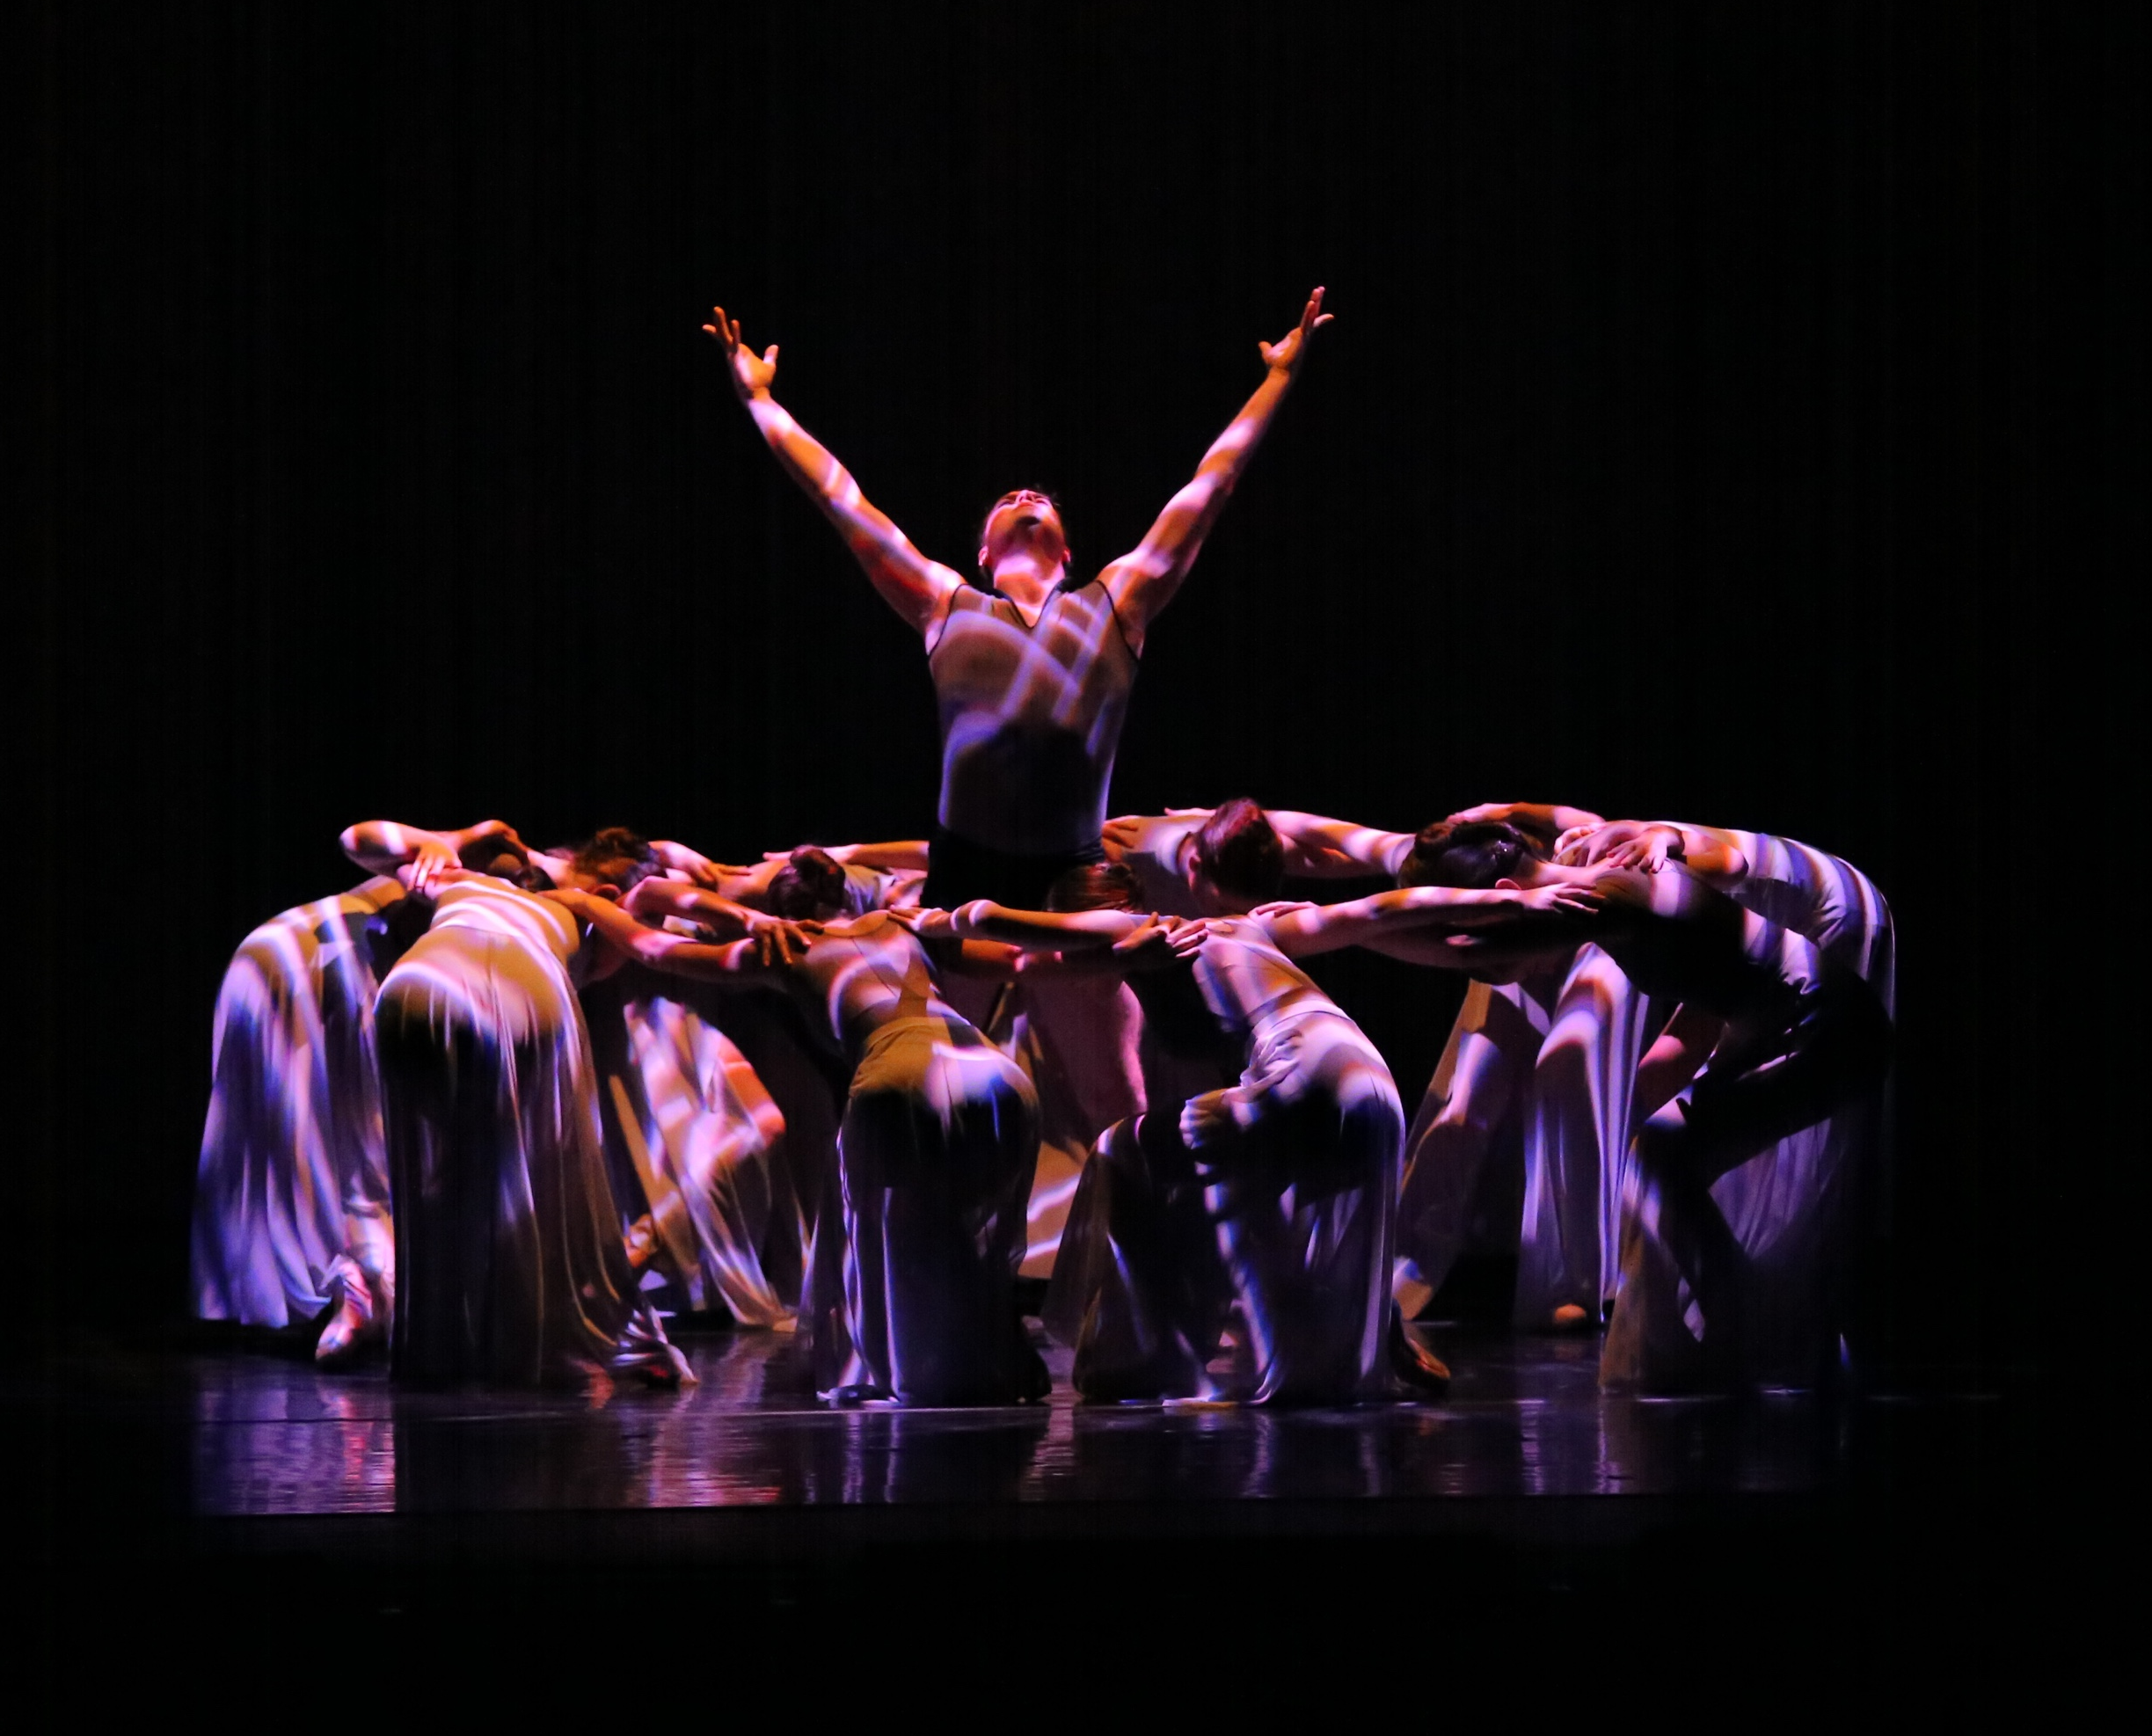
For Then
Chattanooga Ballet
Choreography: Christopher Stuart

Slide 7
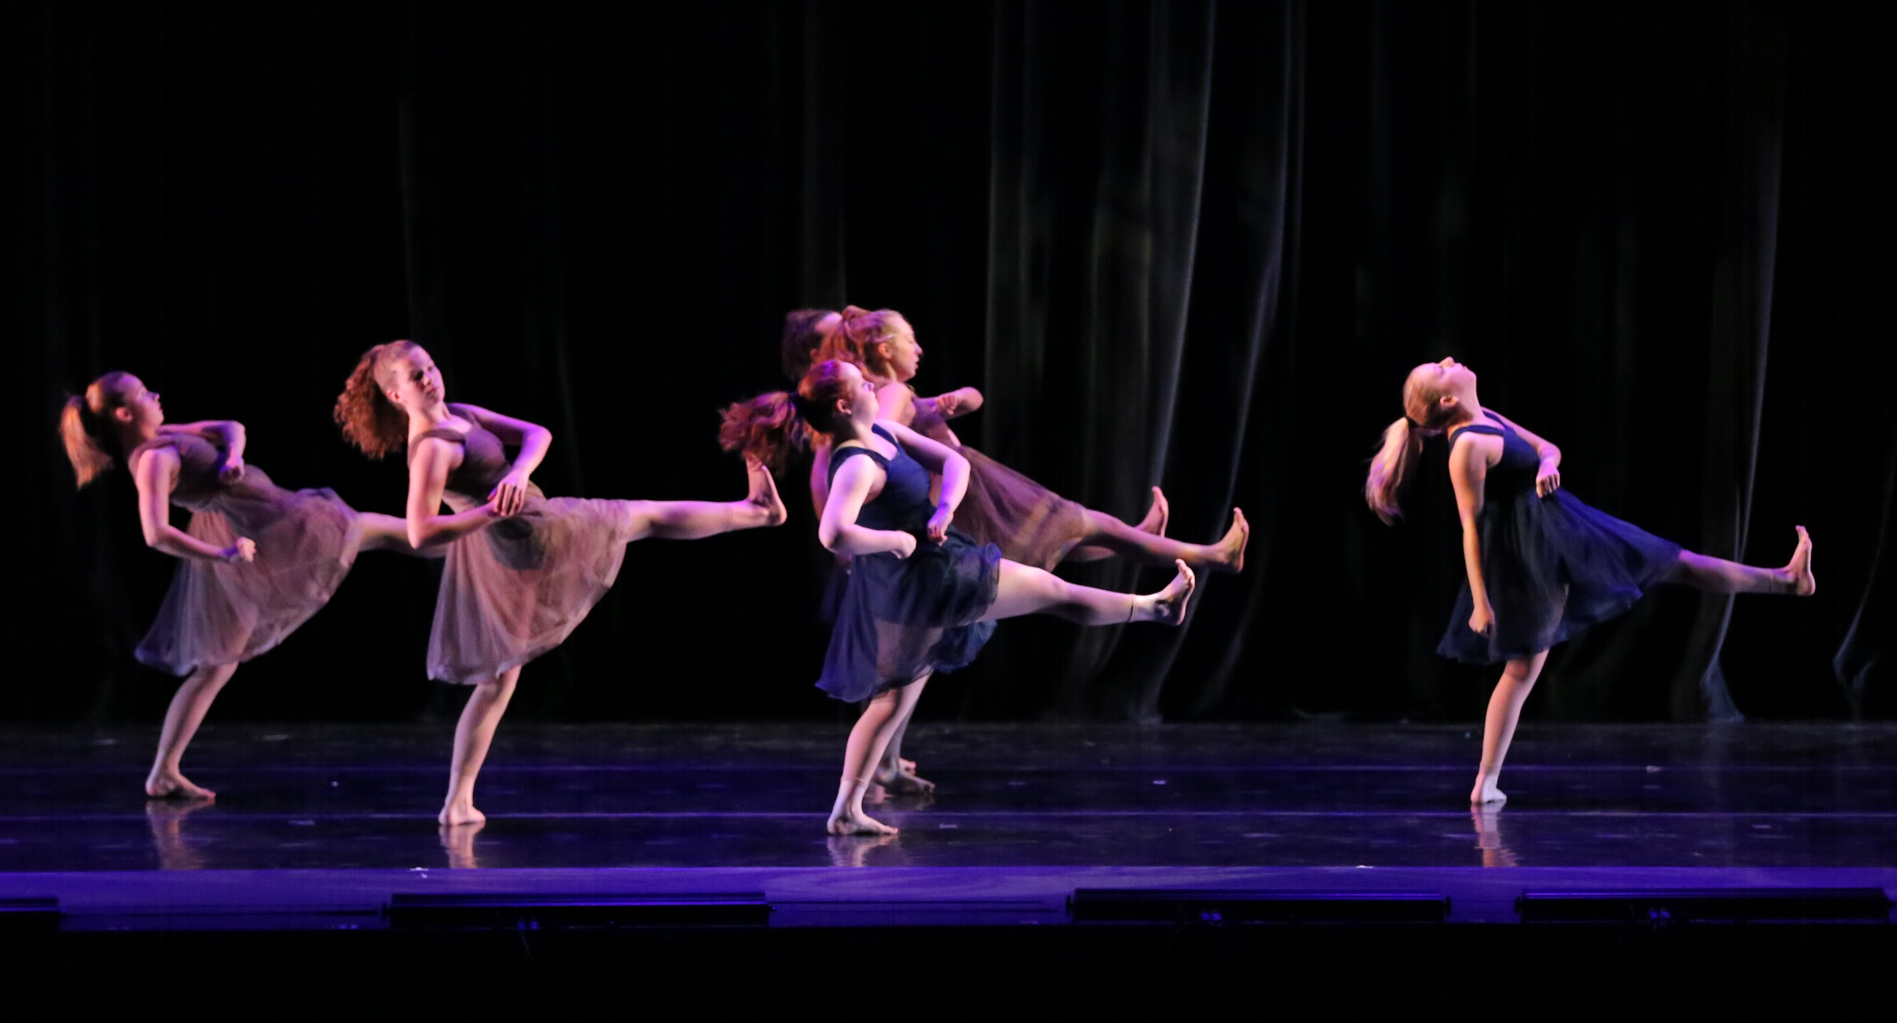
I Need You
Terpsichord/GPS: Choreography: Meredith Bevill & Eva Goldbach
Divisible Unrest
GPS/Terpsichord
Choreography: Maddie Humble & Carson Thatcher

Slide 8
Fulcrum
Project Motion/CCA
Choreographic Direction: Jessica Laliberte Bowman with movement invention by the dancers

